Slide 1
Stats 133 Grade Distribution
Pui Fung (Steven) Lam
Alexander Lee

Slide 2
About this Project
This project is reproducible and is not limited to stats 133 in particular.
The university has records on how students perform from different semester and sections.
Our group was curious on how we could analyze grade distribution for a class and we chose this one.

Slide 3
Research Questions
Near the end of each semester, everyone asks the following questions
What are my chances of getting a certain grade?
How many students get A or B?
What is the average grade of this class?
Which professor grades the easiest?

Slide 4
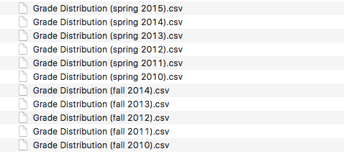
Collecting our Data
Every Berkeley Students have access to CalAnswers
CalAnswers is the database where we exported the CSVs from.
We wanted the letter grades of each student from Fall 2010 - Spring 2015

Slide 5
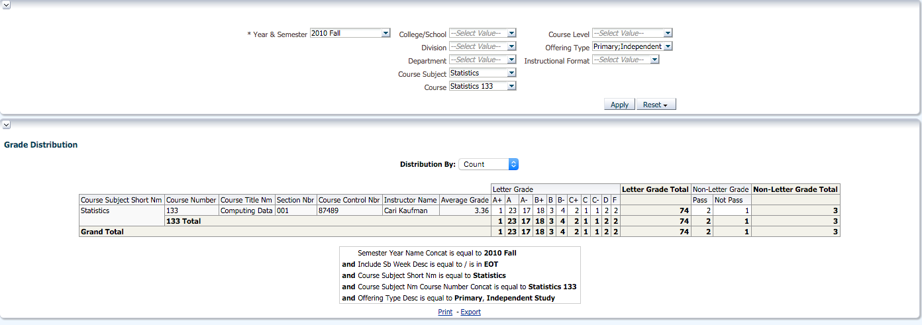
Example of our raw data

Slide 6
How we clean our data?
We excluded the columns that we didn’t want (i.e. students that are P/NP)
and merge all the grade frequencies of 11 semesters,
We got it down to a vector

Slide 7
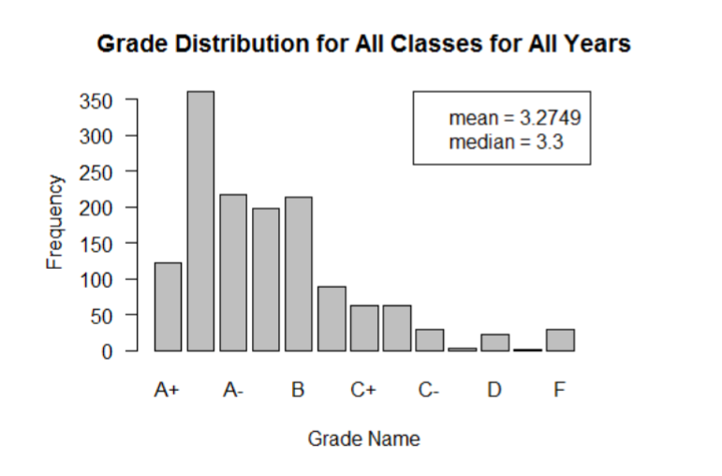
Graph cumulative data

Slide 8
Graph for individual professors
We did a similar graph for and separate each professors that have taught the course in order to pinpoint individual statistics.
Each chart shows the frequency of each grade (A+, A, A-, etc.) and lines indicating the average grade for that class. Classes are arranged by teacher.

Slide 9
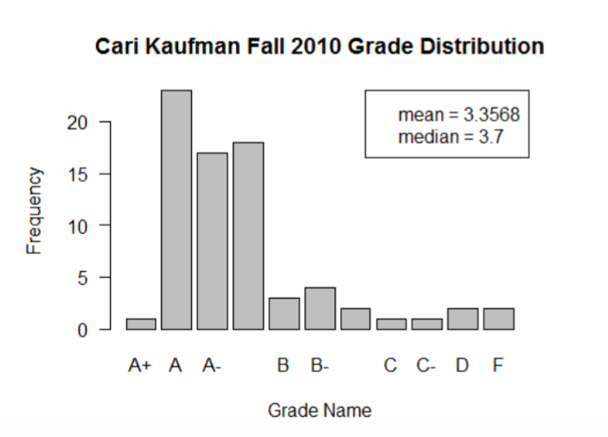
Graph for Professor Kaufman

Slide 10
Subsetting through our data
We compared how each professor graded when they taught the course.
Limitations: Some of the professors taught the course more frequently throughout the time span from fall 2010-spring 2015.
The size of the class has progressively increase as well.

Slide 11
Grades Breakdown by Professors
Cari Kaufman (3): mean= 3.4229, median= 3.7
Deborah Nolan (3): mean= 3.4229, median=3.7
Fletcher Ibser (4): mean= 3.1889, median=3.3
Benoit Dherin (2): mean= 3.0995, median=3.0
Ingileif Hallgrimsdottir (2): mean=3.3053, median=3.7
Philip Spector (2): mean= 3.0414, median=3.0
Haiyan Huang (1): mean=3.3537, median=3.3

Slide 12
Analysis
Before taking stats 133, I’ve been recommended to take the class with Deborah Nolan. I was convinced by information being passed down.
But now, I do have substantial evidence to back up that claim.

Slide 13
Analysis
Historically, the average grade for students is 3.2749 (almost B+)
percentage of students with A 49.75%
-Chances are you need to do better than half the class to get an A
percentage of students with B 35.49%
85% of students get B or above

